Slide 1

WELCOME SMAC!
2022 Spring Leadership Academy

Slide 2
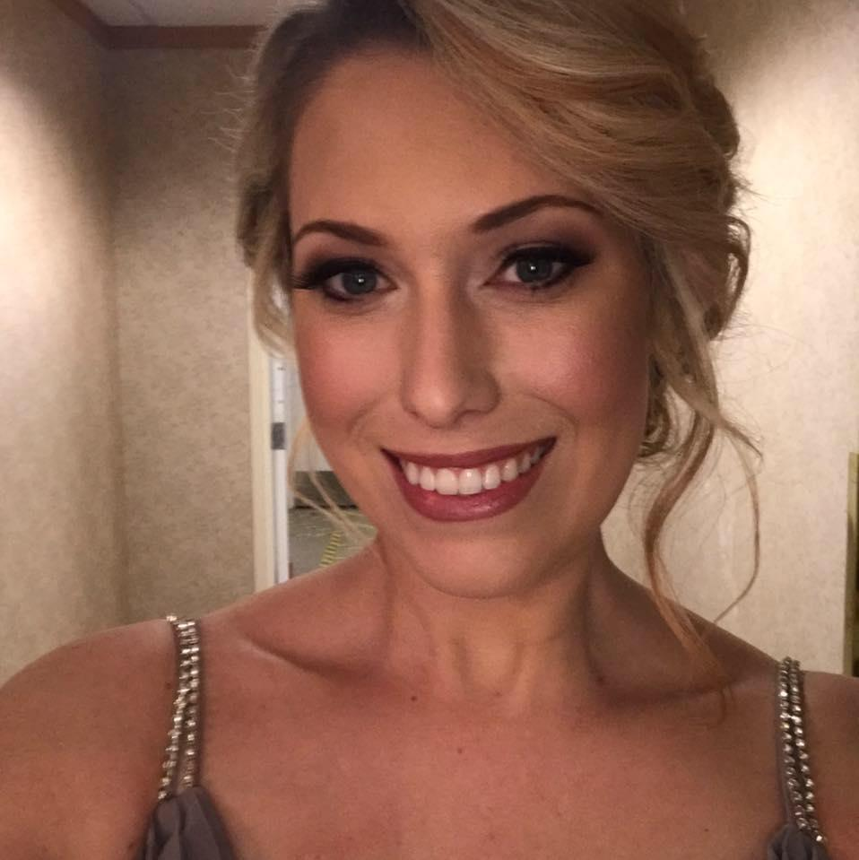
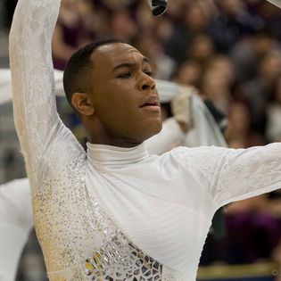
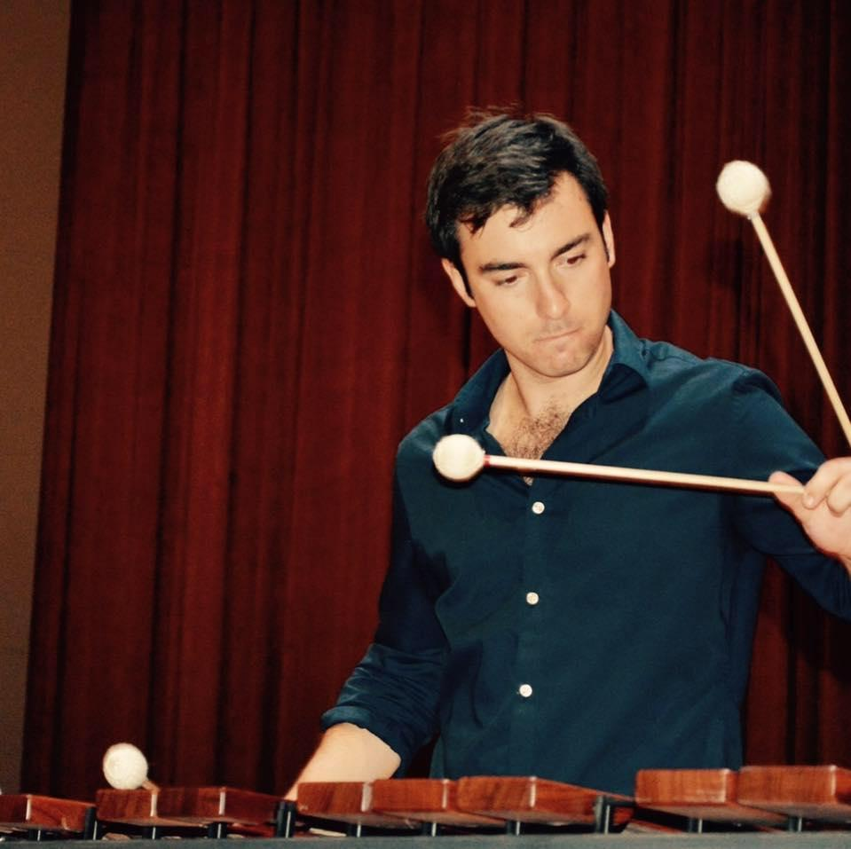
Our Staff
John “M” Miliauskas
Director of Athletic Bands
Jalen “JaySway” Swain
Administrative Assistant
Color Guard Director
Taylor “Yoz” Yozwiak
Assistant Director of Athletic Bands
Percussion Director

Slide 3
Honor, Privilege, Responsibility
Extension of the Band Director

Slide 4
Goals for the Day
Culture and Leadership, Creating Excellence, Teaching, Your Responsibilities
Instructing Your Section
Summer/Band Camp Planning

Slide 5
Introductions Around the Room

Slide 6
Ice Breaker!
Drum Majors…

